Slide 1
HTML Containers
Containers & Parent Containers | Block Elements | Inline Elements |
Notes:
Welcome to our lecture on HTML containers. In this lecture we will go through the conatiners and parent containers, block elements, inline elements, and finally we will see the differencce between block versus inline elements using google dev tools. Let’s start the lecture.

Slide 2
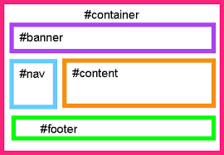
Containers and Parent Containers
Containers: Elements with opening and closing tags in a web document, used to organize and format content.
Styling: Containers can have styles applied to adjust margins, padding, alignment, and other visual attributes.
Parent Containers: A container that holds another element within it.
Notes:
The containers are elements in a web document with opening and closing tags, used to organize and format content. They can be styled to adjust margins, padding, alignment, and visual attributes. A parent container holds another element within it, providing structure and hierarchy for web content.

Slide 3
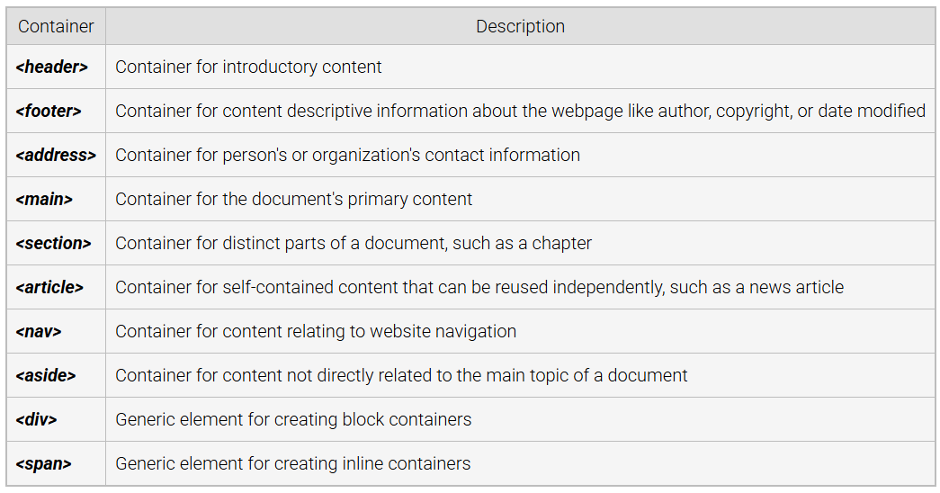
Common HTML Containers
Notes:
These are some common HTML containers include elements like header and footer for introductory and descriptive content. Address is used for contact information. Main and section organize primary and distinct document content. Article holds reusable content. Nav is for navigation links. Aside is for related information. Div and span are generic containers for block and inline elements without semantic meaning.

Slide 4
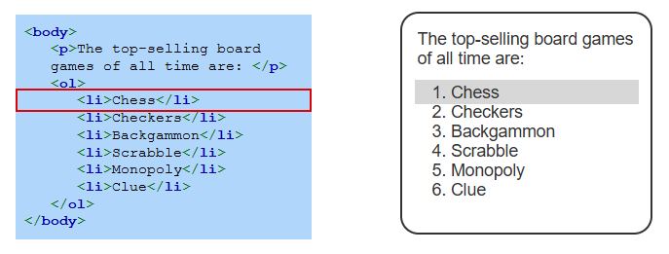
Example
Notes:
This example shows an ordered list in HTML, where the top-selling board games are listed. The code uses the ol tag for the ordered list and li tags for each list item, such as Chess and Checkers. The output displays the list as numbered items, starting with Chess as item one. This demonstrates how HTML structures content for clarity and formatting in web documents.

Slide 5
Block Elements
Block Elements: Fill the width of the parent container and can contain block elements, inline elements, and text (e.g., <h1>, <table>, <p>).
Restrictions: Some block elements, like <p>, cannot contain other block elements when the meaning becomes unclear.
Display: Typically start and end on new lines (e.g., <ol> creates separate lines for ordered lists).
Generic Block Container: <div> is a block element with no semantic meaning, unlike <p> or <table>.
Notes:
Now we will discuss the Block elements that fill the width of the parent container and can include block elements, inline elements, and text such as headings, tables, and paragraphs. Some block elements like paragraphs cannot contain other block elements to avoid unclear meaning. They typically start and end on new lines, such as ordered lists. Div is a generic block element with no semantic meaning, unlike paragraphs or tables.

Slide 6
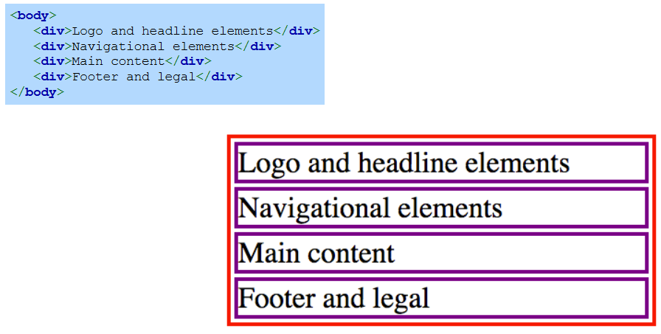
Example
Notes:
This example demonstrates the use of div elements as block containers. The HTML code structures the content into sections, including logo and headline elements, navigational elements, main content, and footer and legal information. Each div serves as a separate block, creating distinct areas of content visually and structurally on the webpage.

Slide 7
Inline Elements
Inline Elements: Occupy the minimum space in the parent container and can contain text or other inline elements (e.g., <a> creates a hyperlink container sized to its content).
Generic Inline Element: <span> is a non-semantic inline element, unlike <a> or <em>.
Best Practices: Use semantic elements like <address> or <article> when possible, reserving <div> and <span> for presentation or interaction when no semantic alternatives fit.
Notes:
Finally, Inline elements occupy minimal space in the parent container and can include text or other inline elements, such as links that resize based on their content. The span element is a generic, non-semantic inline element, unlike elements like links or emphasis. Best practices suggest using semantic elements like address or article, reserving div and span for presentation or interaction when no semantic option exists.

Slide 8
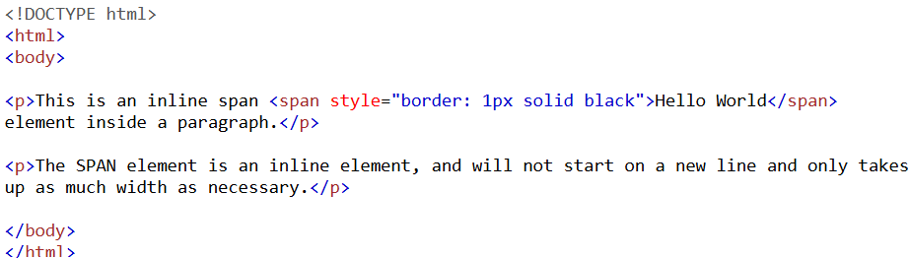
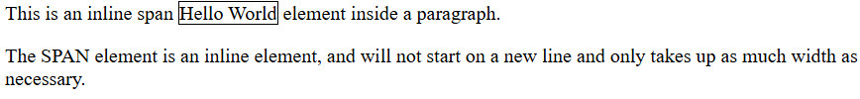
Example
Output
Notes:
This example shows how the span element works as an inline container. The HTML code places a styled span with a border inside a paragraph. The span does not start on a new line and only takes up as much space as its content, shown here as "Hello World." Inline elements like span integrate seamlessly within text, maintaining the flow of content without breaking into new lines.

Slide 9
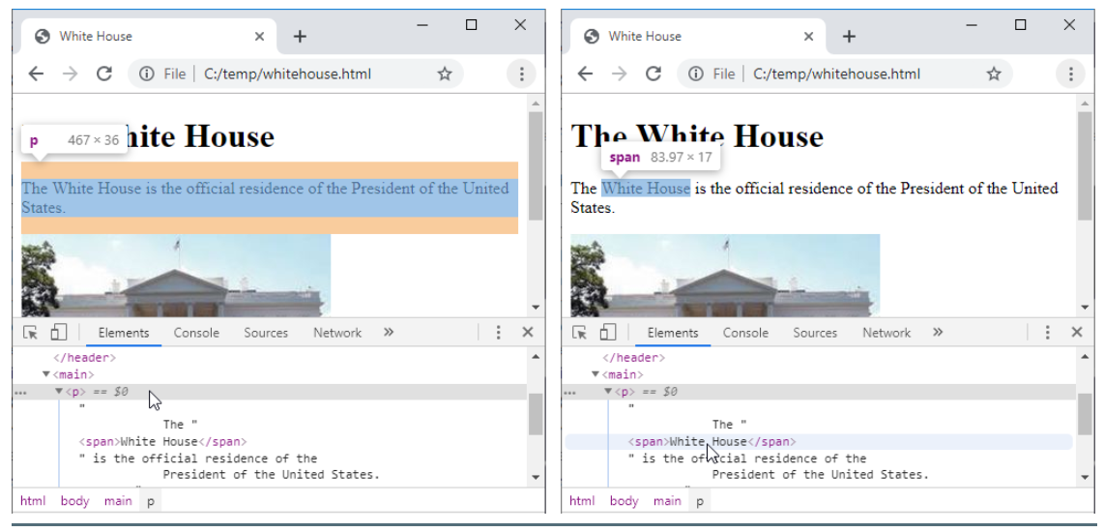
Block vs. inline in Chrome Dev Tools
Notes:
This example shows difference between block and inline elements in Chrome Dev Tools. When hovering over a paragraph element in Dev Tools, a rectangle highlights the entire paragraph, spanning the browser's width since the paragraph is a block element. In contrast, when hovering over a span element, the rectangle only covers the span's content, as the span is an inline element. Thanks for watching the lecture.

